Slide 1
Unit 6 Visible Surface Detection Methods (LH 2)

Slide 2
A – Buffer Method
• The A-buffer (anti-aliased, area-averaged, accumulation buffer) is an extension of the ideas in the depth-buffer method (other end of the alphabet from "z-buffer").
• The A-buffer is incorporated into the REYES ("Renders Everything You Ever Saw") 3-D rendering system.
• The A-buffer method calculates the surface intensity for multiple surfaces at each pixel position, and object edges can be anti aliased.

Slide 3
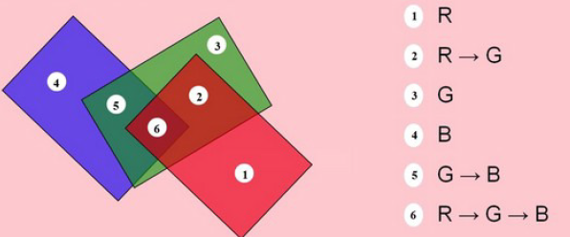
Each position in the A-buffer has two fields −
Depth field − It stores a positive or negative real number
Intensity field − It stores surface -intensity information or a pointer value

Slide 4
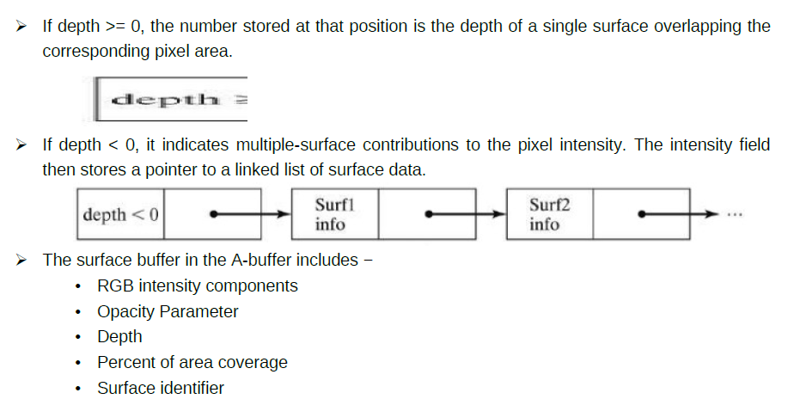

Slide 5
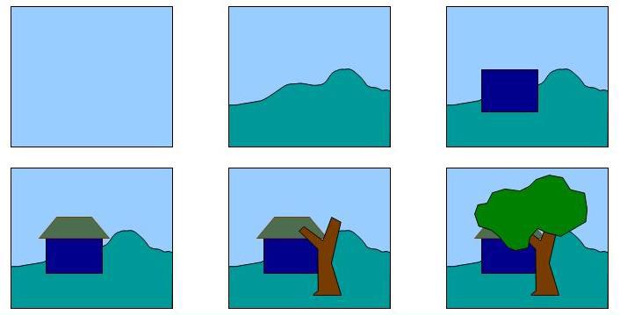
DEPTH SORT (Painter Algorithm)
This method uses both object space and image space method.
• In this method the surface representation of 3D object are sorted in of decreasing depth from viewer.
• Then sorted surface are scan converted in order starting with surface of greatest depth for the viewer.

Slide 6
1.Sort all polygon surface according to the smallest (farthest) Z co-ordinate of each.
2.Resolve any ambiguity this may cause when the polygons Z extents overlap, splitting polygons if necessary.
3.Scan convert each polygon in ascending order of smaller Z-co-ordinate i.e. farthest surface first (back to front)

Slide 7
Algorithm
This algorithm is also called "Painter's Algorithm" as it simulates how a painter typically produces his painting by starting with the background and then progressively adding new (nearer) objects to the canvas.
• Thus, each layer of paint covers up the previous layer.
• Similarly, we first sort surfaces according to their distance from the view plane.
The intensity values for the farthest surface are then entered into the refresh buffer. Taking each succeeding surface in turn (in decreasing depth order), we "paint" the surface intensities onto the frame buffer over the intensities of the previously processed surfaces.

Slide 8
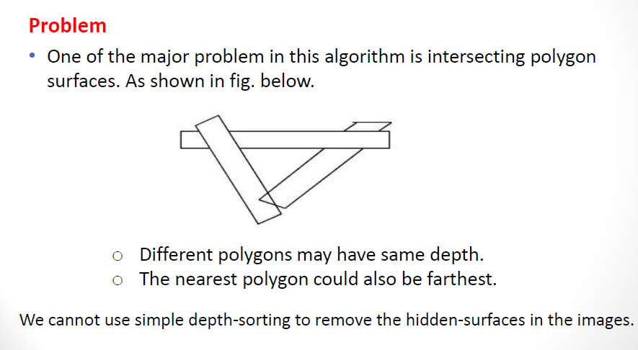

Slide 9
Solution
•For intersecting polygons, we can split one polygon into two or more polygons which can then be painted from back to front. This needs more time to compute intersection between polygons. So it becomes complex algorithm for such surface existence.

Slide 10
Scan-Line Method
• It is an image space method.
• Extension of scan line algorithm for filling polygon interiors
• Instead of filling just one surface, we deal with multiple surfaces
• As each scan line is processed, all polygon surfaces intersecting that line are examined to determine which are visible.
• Across each scan line , depth calculations are made for each overlapping surface to determine, which is nearest to view plane.
• When the visible surface has been determined , the intensity value for that position is entered into the refresh buffer.

Slide 11
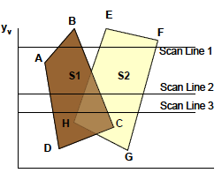

Slide 12
For scan line 1
•The active edge list contains edges AB,BC,EH, FG
•Between edges AB and BC, only flags for s1 == on and between edges EH and FG, only flags for s2==on
•No depth calculation needed and corresponding surface intensities are entered in refresh buffer
For scan line 2
•The active edge list contains edges AD,EH,BC and FG
•Between edges AD and EH, only the flag for both surfaces == on
•Between edges EH and BC flags for both surfaces == on
•Depth calculation (using plane coefficients) is needed.

Slide 13
• In this example ,say s2 is nearer to the view plane than s1, so intensities for surface s2 are loaded into the refresh buffer until boundary BC is encountered
• Intensities for s2 are loaded on refresh buffer
For scan line 3
• Same coherent property as scan line 2 as noticed from active list, so no depth

Slide 14
Note :
• The edges are sorted in order of increasing x
• Define flags for each surface to indicate whether a position is inside or outside the surface

